Slide 1

PEPANZ UPDATE TO CHRISTCHURCH BUSINESS CLUB
The future of oil and gas in New Zealand
.
10 February 2020
John Carnegie
CEO, PEPANZ

Slide 2

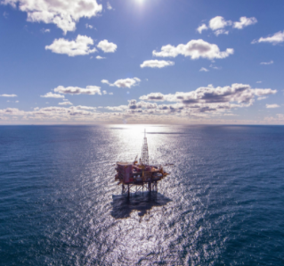
Importance to New Zealand
Oil and gas provide 54% of New Zealand’s energy
Contribute $2.5 billion to the economy per year
$500m per year to Crown in taxes & royalties
11,000 jobs

Slide 3
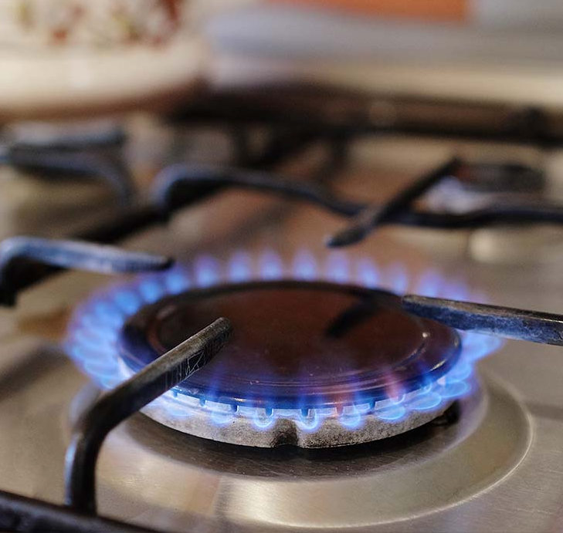
Natural gas
Provides 21% of New Zealand’s total energy
Around half used for methanol (exported) and fertiliser
12% of electricity – a crucial back-up to renewables
Widely used by industry: dairy plants, timber etc
400,000 domestic users of gas or LPG

Slide 4
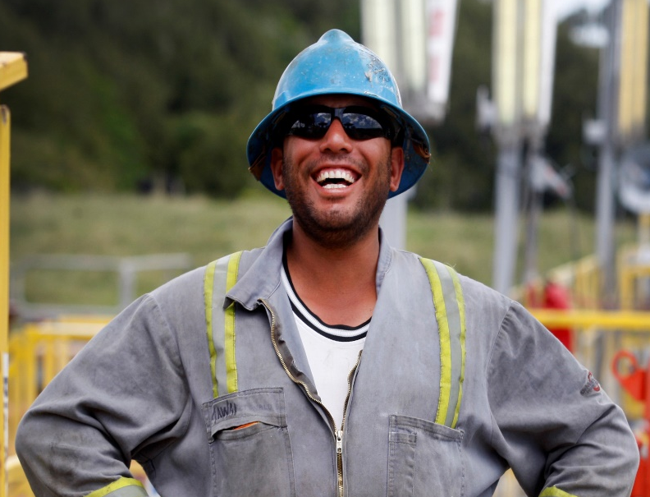
New Zealand’s oil
High quality - nearly all exported overseas for processing into petrol
Cannot generally be processed at Marsden Point refinery
Earns around $1 billion per year in exports
A partial ‘natural hedge’ to our oil imports

Slide 5
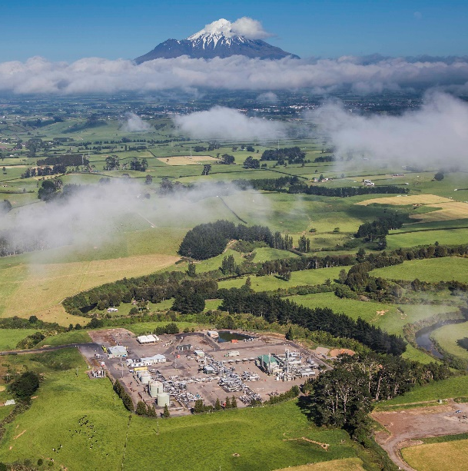
What about climate change?
The world must lower emissions and we are part of the solution
An enormous challenge to do this while providing enough energy for 9 billion people by 2040
Renewables are growing but only 5% of global supply
We will still use oil and gas as we transition to a lower emissions world, so it makes sense to develop local sources rather than importing

Slide 6

Natural gas is the future
45% growth in global demand expected by 2040
Seen as a clean, lower carbon solution by most of the world
Half the emissions of coal
Supports renewable electricity
Exporting natural gas to Asia could be the single biggest contribution New Zealand ever makes to reducing emissions

Slide 7
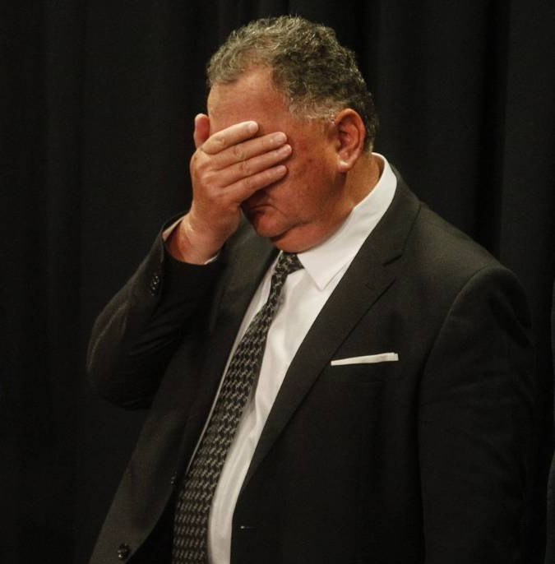
New exploration ban
No new exploration permits to be granted beyond onshore Taranaki (85% of current total production is offshore)
Existing permits for production and exploration will be honoured and able to be progressed
NZIER estimates cost at $28 billion with ‘negligible’ impact on emissions

Slide 8
An uncertain future
All existing permits have ‘drill or drop’ commitments in next two years
Energy and electricity prices are tied to gas availability and will begin to rise in next few years (without new discoveries)
10 years of natural gas supplies left – what comes next?
New development focussed on existing Taranaki fields and offshore South Island

Slide 9
Drill or drop?
Hidden in this jargon is a critical risk to our energy security
∼ 100,000
Offshore acreage
Time
2030

Slide 10
Gas prices and hydrology
Pohokura dispatch
Daily, 2018-19
Pohokura dispatch vs NZ hydro storage
Daily, 2018-19
Source: John Kidd, Enerlytica

Slide 11
Gas prices and electricity
Pohokura dispatch vs spot gas price
Daily, 2018-19
Spot gas vs spot electricity
Monthly, 2018-19
Source: John Kidd, Enerlytica

Slide 12
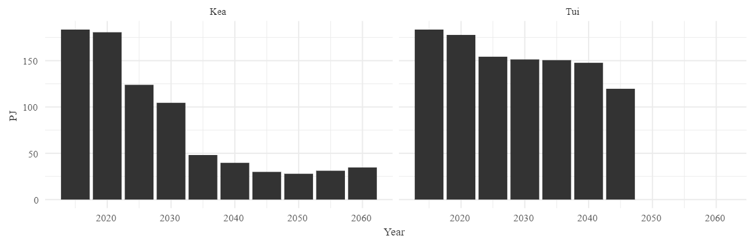
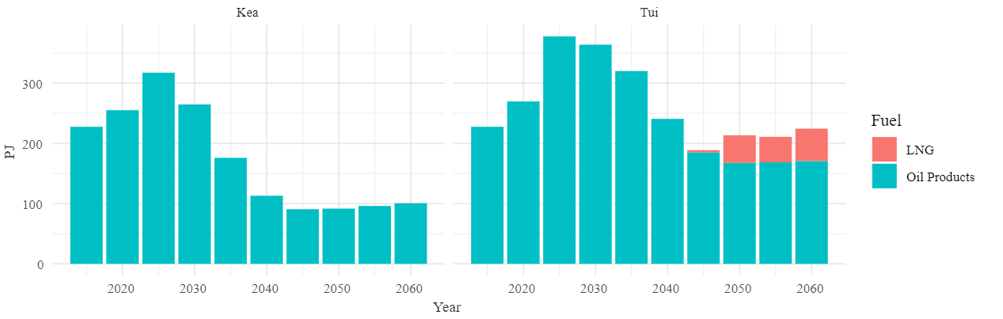
Are we sleepwalking to gas imports?
Domestic gas production
Fuel imports

Slide 13
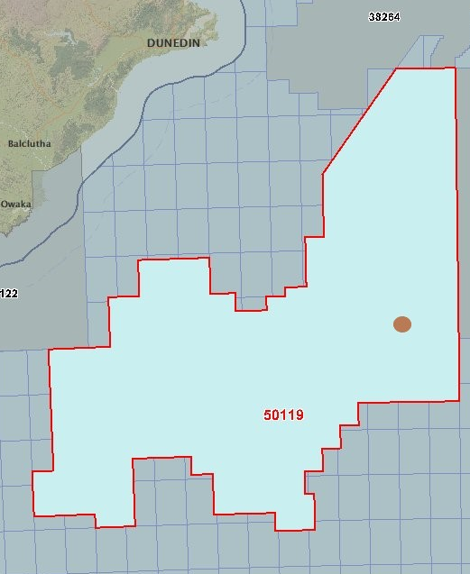
Great South Basin
OMV are currently drilling in Great South Basin 160km southeast from Dunedin
Odds are roughly one in six of a commercial discovery
Could be natural gas and/or oil; used domestically or exported

Slide 14
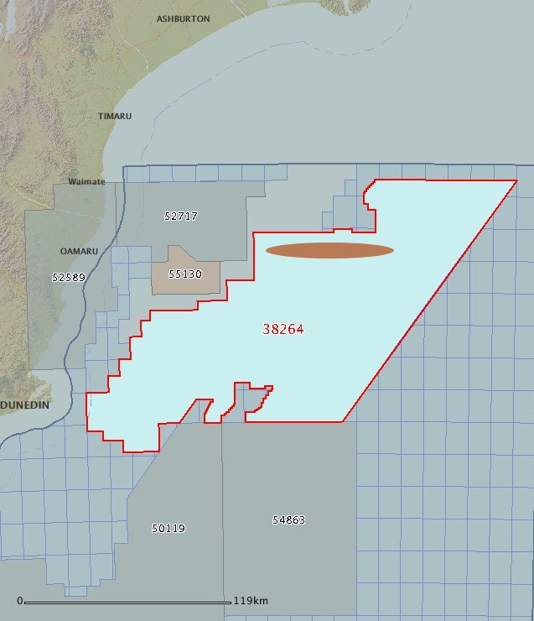
Wherry prospect
Beach Energy committed to drilling a well by October 2021
100km from Oamaru
Five offshore Canterbury wells have been drilled since 1970

Slide 15
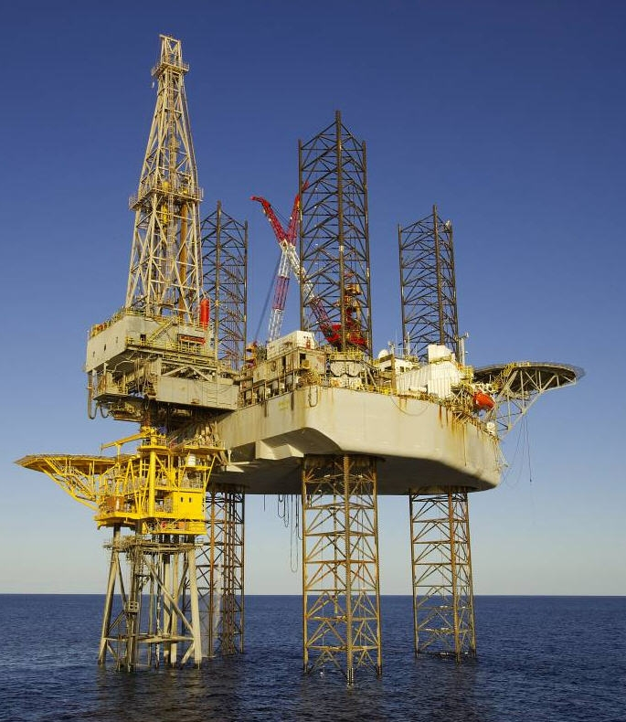
What could a big discovery be worth?
Study on Barque prospect near Oamaru:
  $32 billion in Crown royalties over 30 years
  Could generate $450 million per year
  Construction alone could create 5700 jobs and $7.1 billion to GDP

Slide 16
Closing thoughts
New exploration around the South Island (and Taranaki) is high stakes
Success could be transformational for New Zealand’s economy and help the world lower emissions
No new developments will mean higher energy prices and likely imported LNG
With Government and community support, we can deliver major economic, environmental and social benefits for New Zealand

Slide 17
Thank you
John Carnegie
john@pepanz.com
Twitter @JohnCarnegie7 @PEPANZ1

